Slide 1
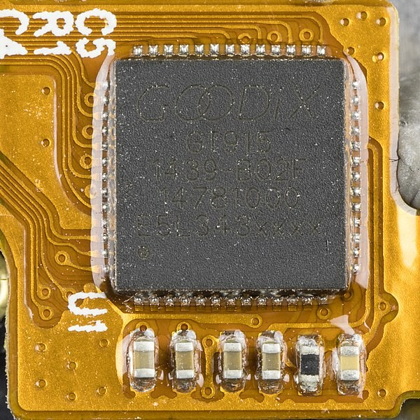
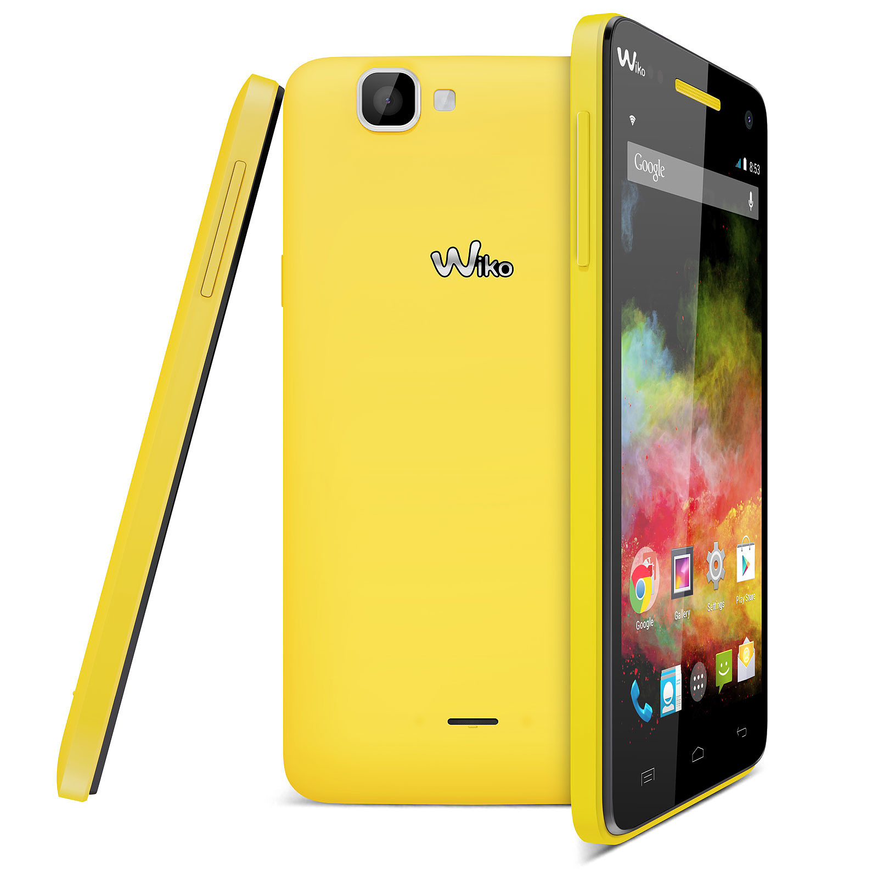
Goodix GT915
large-screen 5:00 capacitive touch chip
inside the phone
Wiko Rainbow 4G

Slide 2
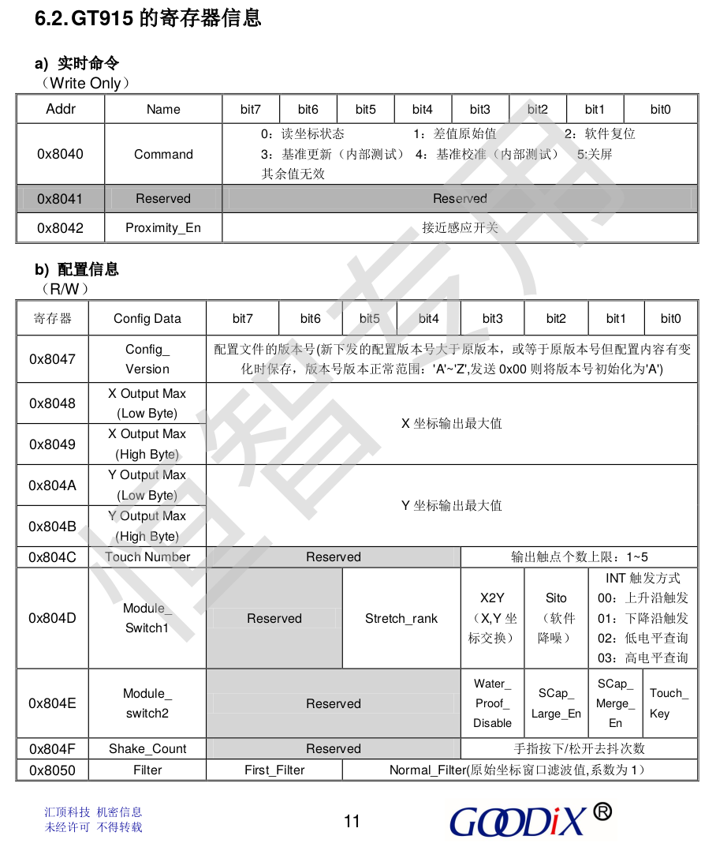
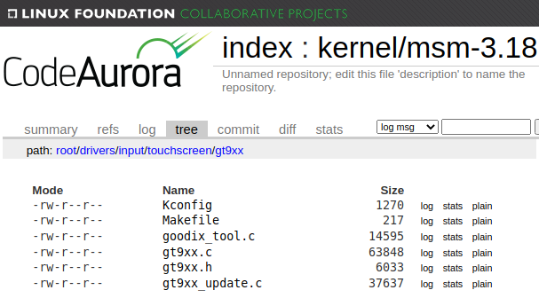
The Code
The GTXX driver source code used for the analysis was taken from this repository ¹ :
The commit used for the analysis is f7d281d16eff5031b39c41e6af6c527ecec31385
The product's official data-sheet was used to model the hardware behavior ² :
¹ https://source.codeaurora.org/quic/la/kernel/msm-3.18/tree/drivers/input/touchscreen/gt9xx?h=LA.HB.1.1.1.c2
² https://datasheetspdf.com/pdf/945606/GOODIX/GT915/1

Slide 3
2 perimeters of analysis
We suppose that the attacker controls the hardware (through interrupts).
Result: proven IMMUNITY to a set of security weaknesses.
We suppose that the attacker has direct access to the device's proc file (through the OS filesystem).
Result: found potential VULNERABILITIES!

Slide 4
On a module of the linux kernel
Kernel Module Source Code
Kernel Module Source Code
Linux Kernel
Skeleton provided by TrustInSoft
Mutex
Input Drv
Mutex
Input Drv
Device
GPIO
Device
GPIO
IRQ
I2C
IRQ
I2C
Mem Mngt
Time
Mem Mngt
Time
Device tree
Kernel
Device tree
Kernel
execution
verification

Slide 5
Analysis result (for interrupts)
We state the total immunity of the GT9xx driver to the set of security weaknesses enumerated below when used according to the model and perimeter of this analysis.
CWE-119 Improper Restriction of Operations within the Bounds of a Memory Buffer
CWE-120 Buffer Copy without Checking Size of Input (‘Classic Buffer Overflow’)
CWE-121 Stack-based Buffer Overflow
CWE-122 Heap-based Buffer Overflow
CWE-123 Write-what-where Condition
CWE-124 Buffer Underwrite (‘Buffer Underflow’)
CWE-125 Out-of-bounds Read
CWE-127 Buffer Under-read
CWE-369 Divide By Zero
CWE-415 Double Free
CWE-416 Use After Free
CWE-457 Use of Uninitialized Variable
CWE-476 NULL Pointer Dereference
CWE-562 Return of Stack Variable Address
CWE-690 Unchecked Return Value to NULL Pointer Dereference

